Slide 1
Road Sign Detection with YOLOv11
Chase Hall
CS-440 — Drones & Mapping
Final Project Presentation
Notes:
“Hi, my name is Chase Hall, and this is my final project: Road Sign Detection with YOLOv11.

Slide 2
Dataset Overview
Data source: Roboflow dataset created by new-workspace-vvjit
4 classes
  crosswalk
  speed limit
  stop
  traffic light.
Images captured in urban street scenes; mix of different angles, scales, and lighting conditions.
875 Total images
  Training set: 613 images
  Validation set: 174 images
  Test set: 88 images
Challenges: small, far-away signs; glare and shadows; cluttered backgrounds.
Notes:
I used a Roboflow dataset called road-sign I found on roboflow explore by new-workspace. It has four classes: crosswalk, speed limit, stop sign, and traffic light. The images are typical street scenes with different angles, distances, and lighting conditions.
The dataset was exported in YOLOv11 format, so each image has a matching text file with the bounding boxes and class labels. The validation set that I evaluated on has 174 images and 232 labeled signs, so on average there are a bit more than one sign per image.
Some of the main challenges in the dataset are small or far-away signs, glare and shadows on the signs, and cluttered backgrounds where other objects can look similar. These issues show up later in the results, especially for the smaller or harder classes.

Slide 3
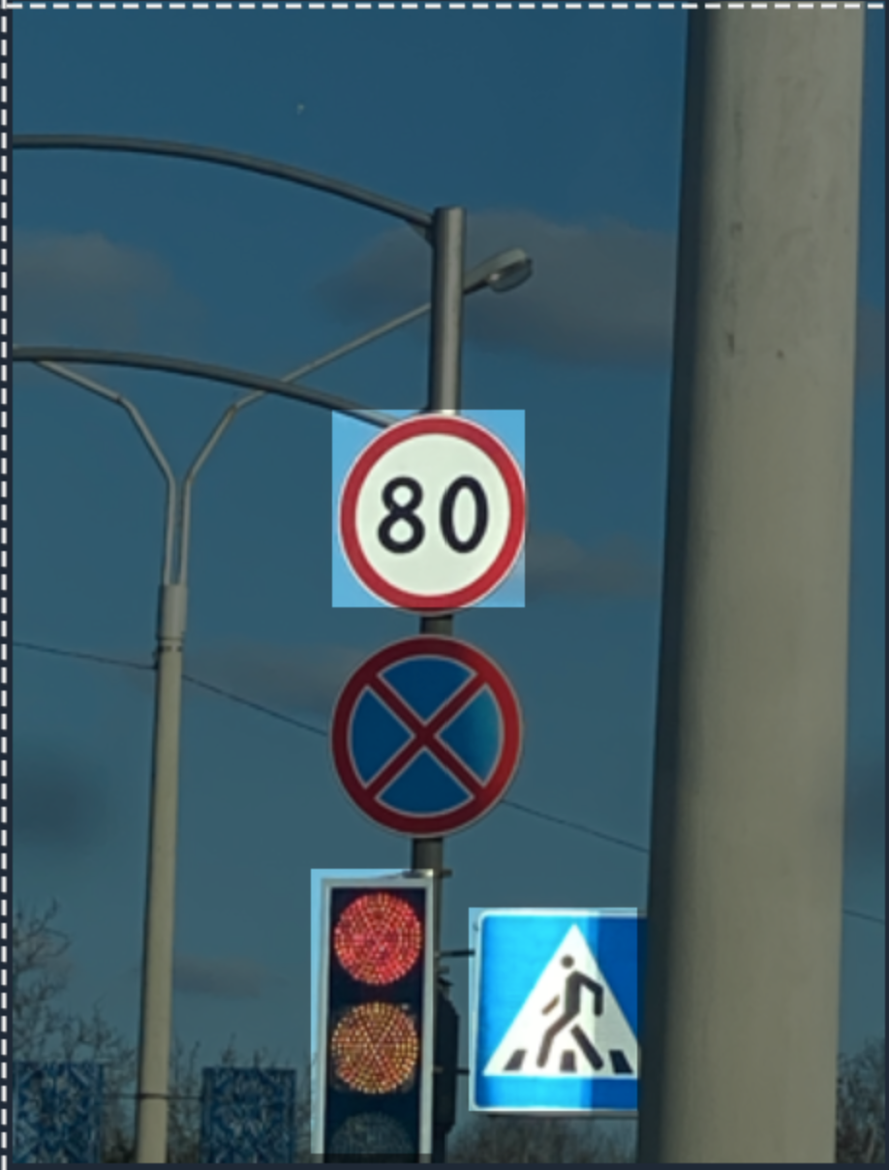
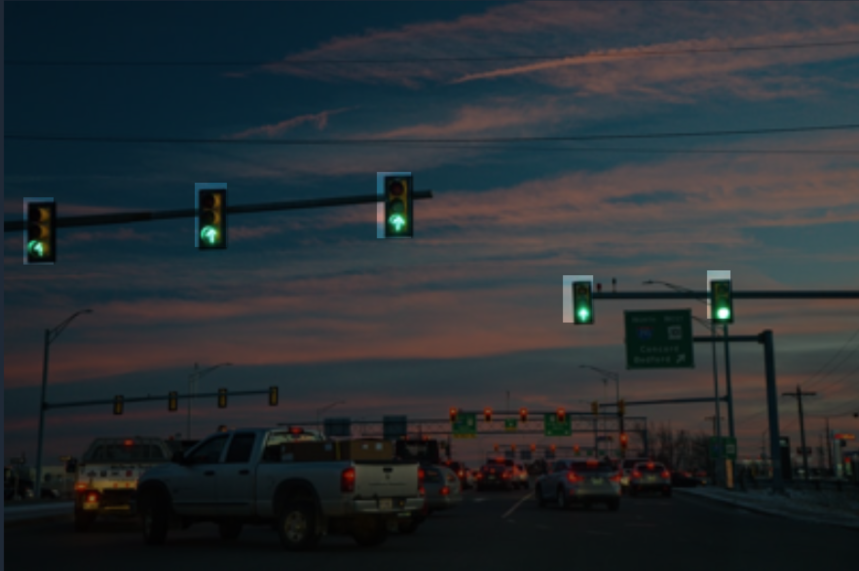
Example Images

Slide 4
Model Architecture & Training Setup
Model: YOLOv11n
Input image size: 640×640.
Training configuration:
  25 epochs
  Batch size: 16
  Data config: data.yaml from Roboflow export
Training environment: Google Colab
Goal: good accuracy while keeping the model small enough for real-time use on drones or edge devices.
Notes:
For the model, I used YOLOv11n. I trained the model with an input size of 640 by 640, using the data.yaml file generated by Roboflow to define the classes and paths. The training configuration was 25 epochs, batch size 16, and I ran it in Google Colab.
trained for 25 epochs because, with a relatively small road-sign dataset, YOLOv11n converges fairly quickly. Beyond ~25–30 epochs, you usually start seeing diminishing returns and more risk of overfitting, while wasting extra GPU time. So 25 was a good balance between model quality and practical training time in Colab.”
“I used a batch size of 16 to balance GPU memory and training stability. On the Colab T4 with 640×640 images, a batch of 16 fits in memory comfortably and gives smooth, stable gradient updates. Smaller batches would make training noisier and slower; much larger batches would likely run into memory issues.”

Slide 5
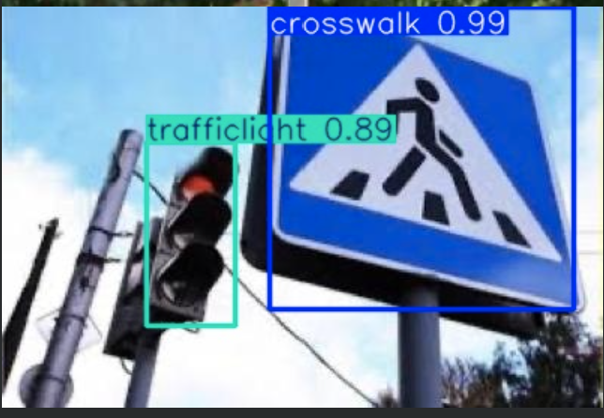
Results Summary
Overall validation performance (all classes):
• Images: 174 | Instances: 232
• Mean Precision (mP): 0.968 (~97%)
• Mean Recall (mR): 0.943 (~94%)
• mAP@0.5: 0.957 (~96%)
• mAP@0.5:0.95: 0.811 (~81%)
Class-wise highlights:
• Speed limit & stop signs: best detection quality (mAP@0.5 ≈ 0.99–1.0).
• Crosswalks: strong but slightly lower recall (~0.91).
• Traffic lights: most challenging class, especially for precise localization.
Notes:
Now for the results. These numbers are from the validation set, which had 174 images and 232 labeled road signs.
Overall, the model did quite well:
The mean precision was about 0.968, or 97%. That means when the model predicts a sign, it’s usually correct.
The mean recall was about 0.943, or 94%, which means it finds most of the signs that are actually there.
The mAP at 0.5 IoU was 0.957, which is strong, and the stricter mAP@0.5:0.95 was 0.811, showing that performance is still solid even when we demand more precise localization.
Looking at the classes individually, speed limit and stop signs are the easiest for the model: they have very high precision and recall, close to 99–100%. Crosswalks also perform well but with slightly lower recall. The hardest class is traffic lights, which have lower localization quality, especially at the stricter IoU thresholds. That usually comes from their small size in the image and more clutter around them.

Slide 6
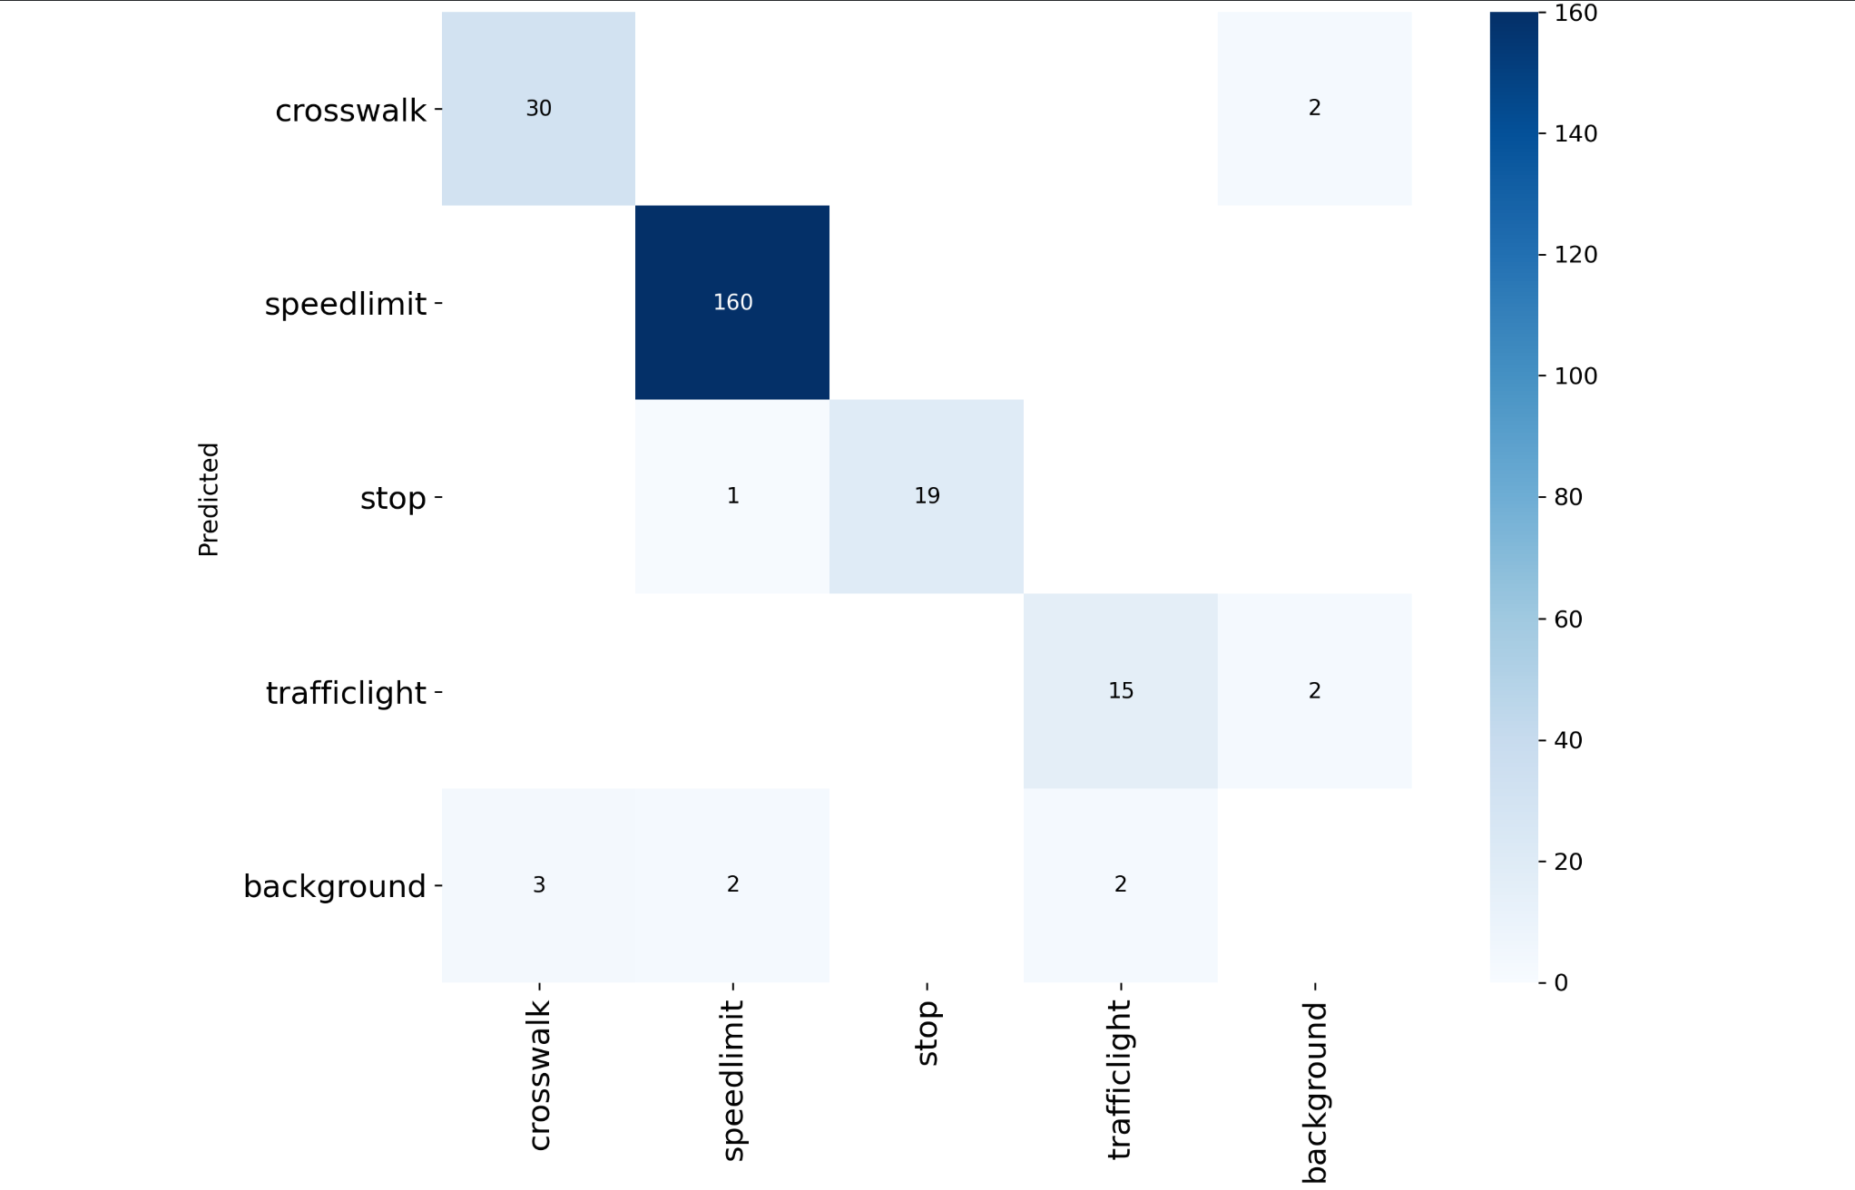
Confusion matrix

Slide 7
Reflection on Drone / Mapping Integration
This model can be deployed on a drone to detect road signs while flying predefined paths.
Combined with 3D mapping tools (e.g., MapMadeEasy), detections could be geotagged and visualized.
Potential applications:
  Updating or verifying road-sign inventories for a campus or city.
  Flagging missing, damaged, or obstructed signs.
  Supporting navigation or safety alerts for autonomous systems.
Key constraint: small distant signs are harder to detect reliably from higher altitudes.
Notes:
“Next, I want to connect this to drone and mapping applications.
Even though this project was trained and tested on static images, the idea is that a similar model could run on a drone flying over roads or a campus. As the drone captures images or video, the model could detect road signs in real time.
If you combine that with a mapping tool, like we used earlier in the course for 3D mapping, you could geotag each detection. That would let you build a map layer showing where crosswalks, speed limit signs, stop signs, and traffic lights are located.
This could be useful for updating a city’s road sign inventory, checking for missing or damaged signs, or supporting navigation systems. The main limitation is altitude and distance: from higher up, the signs get tiny in the images, which is exactly the kind of scenario where the model struggles more. So there’s a trade-off between flight height, coverage, and detection reliability.

Slide 8
Lessons Learned & Next Steps
Lessons learned:
  Data quality and diversity matter as much as model choice.
  Small objects (like far-away signs) are the main failure mode.
  Visualization of results (confusion matrix, per-class metrics) helps diagnose issues.
Next steps:
  Add more images of small/distant signs and night-time conditions.
  Experiment with larger YOLOv11 variants (s/m) or fine-tune anchor settings.
  Integrate detections into a full drone mapping pipeline with GPS and 3D map overlays.
  Explore on-device inference on a small edge computer mounted on the drone.
Notes:
o wrap up, here are a few lessons I learned and some possible next steps.
First, I learned that data quality and diversity are just as important as the model architecture. The model performs very well on medium and large signs, but performance drops on very small or distant objects. That suggests I would benefit from more training images where the signs are smaller, occluded, or in harder lighting conditions.
Second, the evaluation tools—like the per-class metrics and the confusion matrix—are really helpful for understanding where the model is failing. In this case, they made it clear that traffic lights are the hardest class and that localization is less precise there.
For next steps, I would:
Add more training data specifically focused on small or far-away signs and maybe different weather or night conditions.
Experiment with larger YOLOv11 variants, like the small or medium models, to see if they improve accuracy enough to still be usable on a drone.
And finally, actually integrate the model into a full drone mapping pipeline, where detections are combined with GPS and 3D maps, so you don’t just detect signs but also place them accurately in the real world.
Overall, this project was a good hands-on experience with dataset handling, training a modern detection model, and thinking about how it fits into a real deployment setting.”

